Slide 1
INVESTMENTS
Week 5: Market Efficiency
Vikas Raman

Slide 2
Outline
Market Efficiency: weak, semi-strong, strong
Empirical Evidence
Momentum
Fundamental Analysis
Mutual Fund Performance
Insider Trading
Asset Pricing and Market Efficiency
Limits to Arbitrage
Hedge Funds & the Dot-Com Bubble
LTCM
Summary

Slide 3
Market Efficiency
In an efficient market prices fully and accurately reflect all available information
If, on average, investors consistently can (cannot) beat the market based on certain information, we say that the market is not (is) informationally efficient with respect to that information

Slide 4
Three Types of Efficiency
Weak-form efficiency
The “information” is historical information on past stock prices.
The past pattern of prices doesn't allow you to make money beyond what would be expected given your risk burden.
Semi-strong form efficiency
Publicly available information (announcements) doesn’t allow you to make money beyond what would be expected given your risk burden.
Strong-form efficiency
All information, including private (insider) information, is reflected.
All the hard work in the world doesn't allow you to make money beyond what would be expected given your risk burden.

Slide 5
Can we predict returns?
Does this make sense?

Slide 6
Can we predict returns?
Stock prices should (approximately) follow a random walk.
P_{t} = μ + P_{t-1} + ε_{t} ε_{t} ~ IID(0, σ²)
r_{t} ~ IID(μ, σ²)
AMD announces that it has produced an inexpensive processor chip. It expects sales to be strong, though the product will not go on the market for a month.
Will AMD's stock have high returns in the next month?
Notes:
If competition means that prices get impounded by information immediately, to profit from trading we have to predict news! But flow of information is random…

Slide 7
Can we predict returns?
“The influences which determine the movements of the Stock Exchange are innumerable. Events past, present or even anticipated, often showing no apparent connection with its fluctuations, yet have repercussions on its course…The determination of these fluctuations is subject to an infinite number of factors: it is therefore impossible to expect a mathematically exact forecast. Contradictory opinions in regard to these fluctuations are so divided that at the same instant buyers believe the market is rising and sellers that it is falling.”
Théorie de la spéculation, Bachelier (1900) (as translated by D. May)
Notes:
If competition means that prices get impounded by information immediately, to profit from trading we have to predict news! But flow of information is random

Slide 8
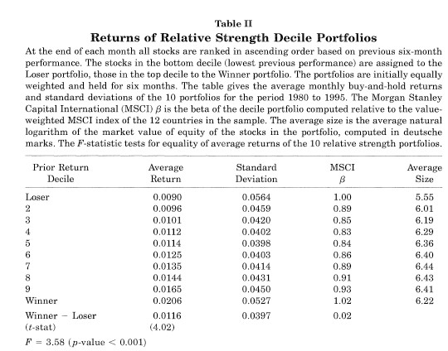
Can we predict returns? Evidence: Rouwenhorst (1998)

Slide 9
Evidence on Efficiency -Fundamental Analysis
Uses economic and accounting information to predict stock prices
Semi strong form efficiency & fundamental analysis
Evidence is mostly consistent with semi strong, but not strong efficiency

Slide 10
Asset Pricing and Market Efficiency
Measuring abnormal returns:
construct trading strategies that earn 'abnormal' returns
Abnormal returns = realized returns – expected (normal) returns
need a model of 'normal' returns (CAPM, APT) where you measure risk correctly
If you find abnormal returns (when you shouldn’t):
(a) market is not efficient (b) model is wrong (c) both
('Abnormal')Return
Realized Return
'Normal' Returns (Single Index Model)

Slide 11
Asset Pricing and Market Efficiency
How do you tell whether the discrepancy between your valuation and the market is due to the faults of your asset pricing model, to market inefficiencies, or both?
This is a fundamental problem in testing market efficiency. You cannot really test one without the other—JOINT HYPOTHESIS.

Slide 12
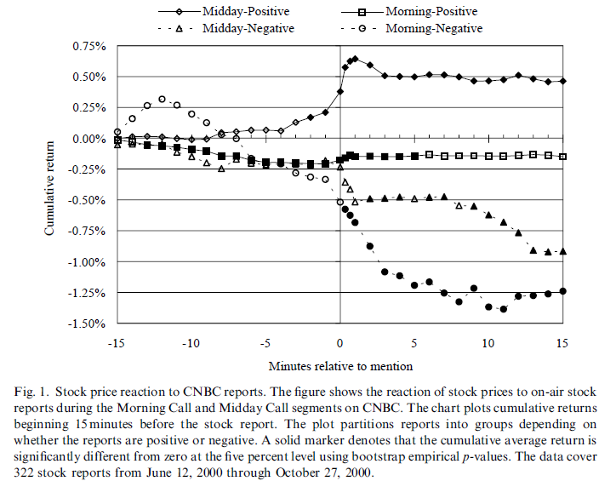
Reaction to news
Source: Busse and Green (2002)

Slide 13
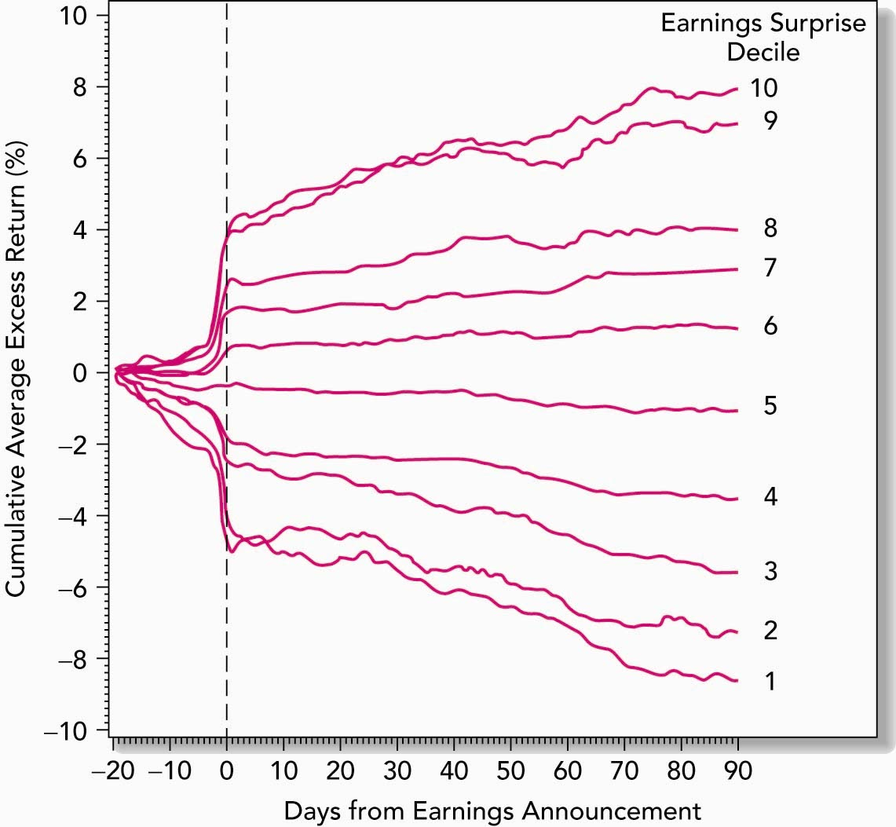
Post-Earnings-Announcement Price Drift
EMH says that stock prices should react immediately to information
Anomaly: stock prices react slowly to earning announcements
What strategy would you implement to exploit this?

Slide 14
Mutual Fund Performance
Do mutual funds earn excess returns because fund managers are either better at picking stocks than most people? or because fund managers have access to private information?
After adjusting for risk and transaction costs, answer seems to be that fund managers are NOT better at picking stocks on average.

Slide 15
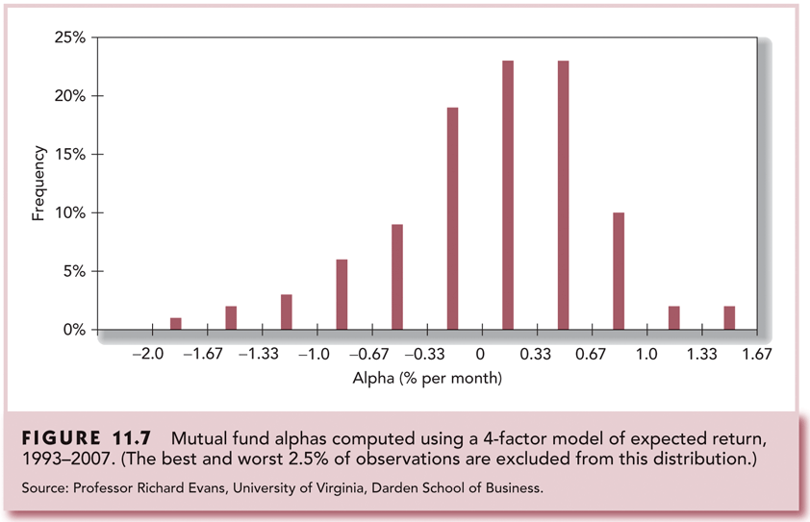
Mutual Fund Performance

Slide 16
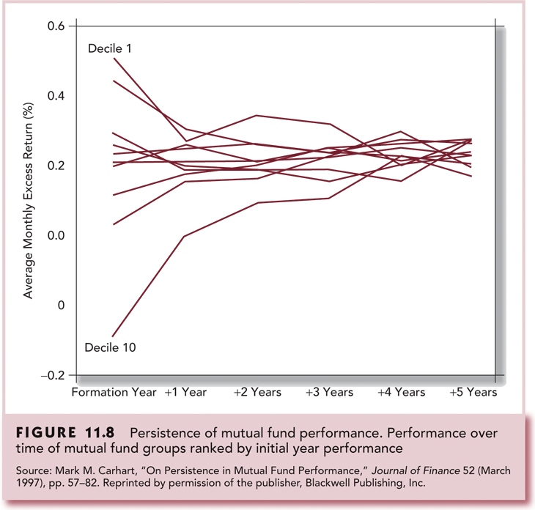
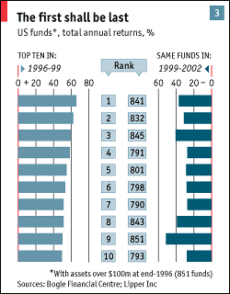
Persistence of Mutual Fund Performance

Slide 17
Mergers
Cumulative abnormal returns (CAR):
Add up the abnormal returns over many period
CAR is the return you receive for holding the stock over the whole period
Evidence consistent with semi-strong market efficiency (why?)
What is going on here?

Slide 18
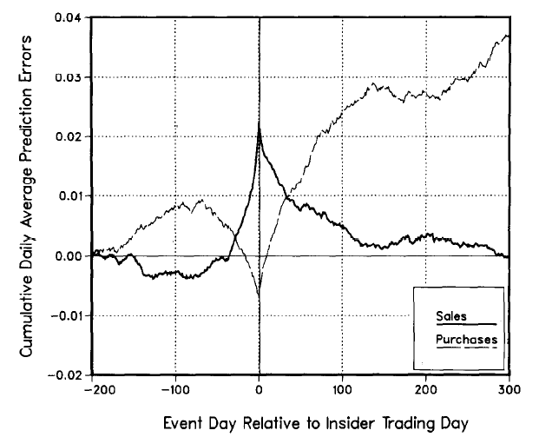
Insider Trading
Source:Seyhun (1986)
Evidence consistent with strong-form market efficiency?

Slide 19
Grossman-Stiglitz Paradox
If the market is (strong-form) efficient and all information (including insider information) is reflected in the price
No one has an incentive to expend resources to gather information and trade on it.
How, then can all information be reflected in the price?
Markets cannot be strong-form informationally efficient, since agents who collect costly information have to be compensated with trading profits.
Source: Grossman and Stigliz (1980) and Brunnermeier (2011)

Slide 20
Insider Trading: what is illegal?
Directors and officers of U.S. companies can trade that company‘s stock so long as:
The trades are not motivated by private information
They report their trades to the Securities and Exchange Commission.
SEC publicizes these reports.

Slide 21
Insider Trading: what is illegal?
Galleon Group was one of the largest hedge funds in the world, managing over $7 billion, before closing in October 2009
In October 2009 Rajaratnam and five others were arrested and charged with multiple counts of fraud and insider trading.
After being on bail for $100 million bail, he was indicted by a grand jury and was sentenced to 11 years in prison on October 13th, 2011.

Slide 22


Insider Trading: what is illegal?
Rajaratnam talking to Rajiv Goel (former Intel official)
Rajiv Goel pleaded guilty
Rajaratnam tells Goel that he knows about a deal involving PeopleSoft and appears to encourage Goel to allow Rajaratnam to buy stock using Goel’s brokerage account.
(first 1min)
Rajaratnam talking to Anil Kumar (former Mckinsey & Co. director)
Anil Kumar received $500,000/yr for non-public information about McKinsey clients.
Anil Kumar pleaded guilty and cooperated
Informing Rajaratnam about a corporate deal by AMD
(first 2 mins)
Rajaratnam talking to Adam Smith (!) (former Galleon Trader)
Adam Smith also was another cooperating witness
Talking about a deal involving Vishay Intertechnology that never happened
(2 mins onwards)
Source: http://blogs.wsj.com/deals/2011/03/11/hear-the-raj-rajaratnam-tapes/

Slide 23

Insider Trading: what is illegal?
Rajaratnam talking to Rajat Gupta (former Mckinsey & Co. CEO and a Goldman Sachs director)
Rajat Gupta was convicted and was sentenced to 2 years in prison in October, 2012.
Rajat Gupta, a Goldman Sachs director, tells Raj Rajaratnam, the founder of hedge fund Galleon Group, that the investment bank had discussed buying a commercial bank in July 2008,
(first 3 mins)
Source: http://podcast.ft.com/index.php?pid=1094

Slide 24
Insider Trading: should it be legal?
Prohibitions on insider trading restrict informed traders (insiders of a firm) from trading
How can that be good for price discovery/market efficiency?
Should insider trading be allowed?

Slide 25
Limits to Arbitrage
Market Efficiency = No Abnormal Profits
No Abnormal Profits = Market Efficiency?
If market frictions limit (rational) investors’ ability to arbitrage mispricing:
No abnormal profits even for the informed
Prices may deviate from ‘true’ value (‘Bubbles’?)

Slide 26
Limits to Arbitrage
Unlike textbook arbitrageurs who instantaneously trade when prices deviate from fundamental values, real world arbitrageurs (finite capital) must overcome various frictions.

Slide 27
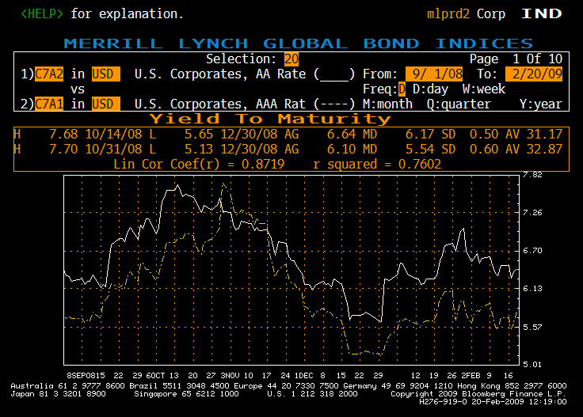
Corporate (10yrs) AAA & AA
Arbitrage????

Slide 28
Limits to Arbitrage
Fundamental risk.
The risk that firm fundamentals will change while the arbitrage strategy is being pursued
Noise Trader Risk
Noise Trader: Someone whose trades are not based on information or financially meaningful analysis.
If trading horizon is short...
Short-Sale Constraints
Synchronization Risk
One trader alone cannot correct the mispricing (can sustain a trade only for a limited time period)
Risk that other rational traders do not act against mispricing at the same time
“So, you think that investors are irrational—but then you expect them to become rational just when you have gone short?”
(A hedge fund manager’s wife, 1999; Source: Brunnermeier and Nagel (2004))

Slide 29
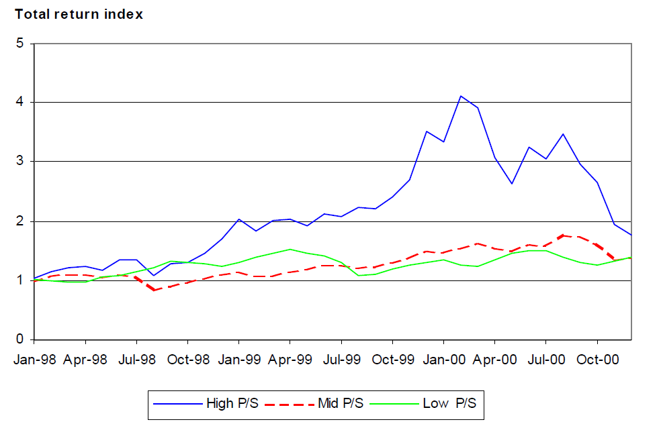
Limits to Arbitrage
Tech Bubble:
Returns for NASDAQ price/sales quintile portfolios 1998-2000
Source: Brunnermeier and Nagel (2004)

Slide 30
Limits to Arbitrage
Weight of NASDAQ technology stocks (high P/S) in aggregate hedge fund portfolio versus weight in market portfolio
Source: Brunnermeier and Nagel (2004)

Slide 31
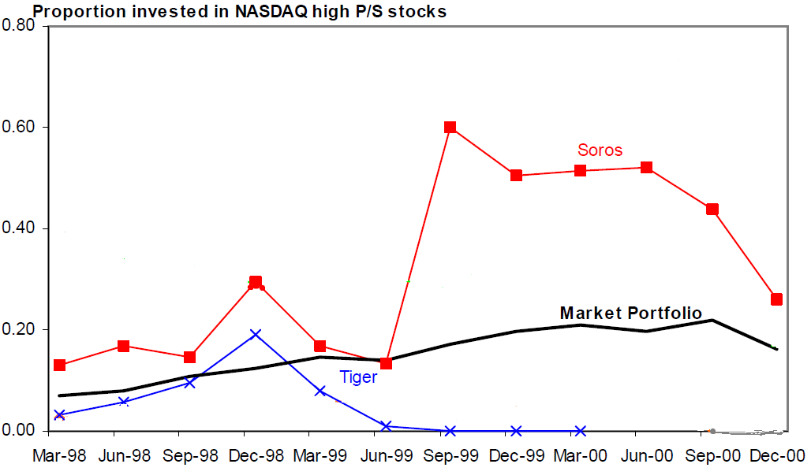
Limits to Arbitrage
Weight of technology stocks in hedge fund portfolios versus weight in market portfolio
Source: Brunnermeier and Nagel (2004)
Soros (Quantum): Stanley Druckenmiller; Tiger: Julian Robertson

Slide 32
Limits to Arbitrage
“The market can remain irrational longer than you can remain solvent”
- John Maynard Keynes (When Genius Failed , 2000, Roger Lowenstein)

Slide 33
Limits to Arbitrage
LTCM (Long Term Capital Management) was founded in 1994 by Myron Scholes, Robert Merton, John Meriwether, and others.
For their first three or four years, they were spectacularly successful.
But they had one bad quarter in 1998, when they lost $4 billion, wiping out their equity capital and forcing the firm to liquidate.
One of the ways that they lost money was on the Royal Dutch/Shell equity arbitrage trade.
Notes:
Warren Buffett on Long Term Capital Management: http://www.youtube.com/watch?v=GKhCzubxOW0

Slide 34
Limits to Arbitrage
In 1907, Royal Dutch of the Netherlands and Shell of the UK agreed to merge their interests on a 60-40 basis, and pay dividends on the same basis.
Whenever the stock prices are not in a 60-40 ratio, there is an arbitrage profit opportunity.
Law of One Price: that any two assets with the same payoff must have the same value or price
Until July 2002, Royal Dutch was in the S & P 500, and Shell is in the FTSE.

Slide 35
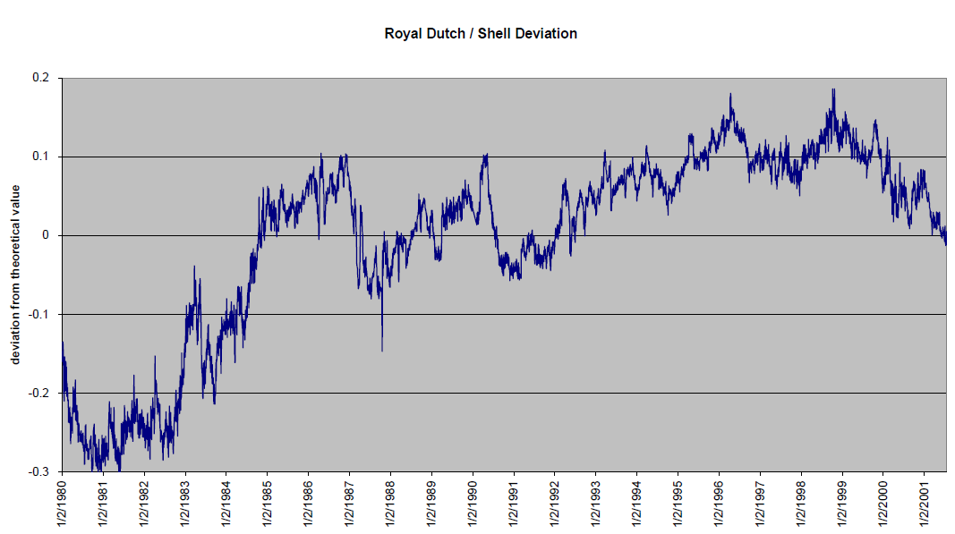
Limits to Arbitrage
Source: Ritter (2003)

Slide 36
Limits to Arbitrage
LTCM placed a massive $2.3 billion position in Royal Dutch Petroleum and Shell Transport. (Source: http://www.businessweek.com/stories/1998-11-08/how-long-term-capital-rocked-stocks-too)
This position is called a pairs trade, or an arbitrage between two stocks, often in the same industry, that usually move closely together but sometimes diverge.
LTCM bet that Shell was cheap compared to Royal Dutch.
LTCM effectively bought shares of Shell Transport and simultaneously sold shares of Royal Dutch.
They lost money when prices diverged further from their theoretical values during the third quarter of 1998.
To meet liquidity needs, LTCM and other hedge funds were forced to sell out their positions
Betting with borrowed money…
Prices converged eventually, but by then LTCM had been liquidated!

Slide 37
Limits to Arbitrage
“The market can remain irrational longer than you can remain solvent”
- John Maynard Keynes (When Genius Failed , 2000, Roger Lowenstein)

Slide 38
Summary
Bulk of evidence is that overall markets are efficient
Still, there seem to be enough anomalies to warrant search for underpricing.
Specifically, Technical Analysis maybe of little value for short-term investments.
Research in general also supports semi-strong form efficiency, but can find examples of semi-strong form inefficiency.
Superior information and/or insight may earn abnormal profits.
Even if investors are collectively rational, mispricing may persist due to the Limits of Arbitrage.

